Slide 1
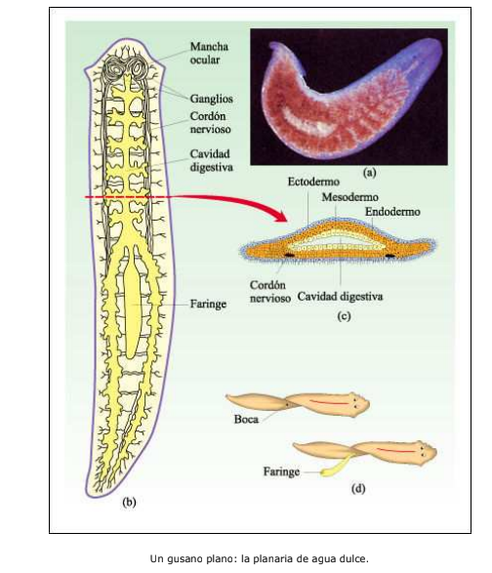
PLANARIAN OBSERVATION: BASIS
  Planarians are very simple multicellular organisms.
  They have a digestive system made up of a stoma (or mouth), pharynx and intestine and a rudimentary nervous system.
Notes:
1

Slide 2
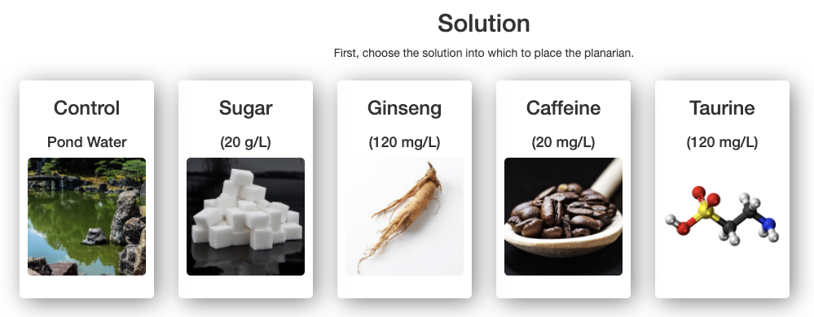
PLANARIAN OBSERVATION: BASIS
REMOTE LABORATORY:
Planarians are flatworms that can be used to study the effect of different substances on the nervous system. In this remote laboratory you can choose the solution into which to place the planarian.

Slide 3
PLANARIAN OBSERVATION: PROCEDURE
1. Choose the control solution.

Slide 4
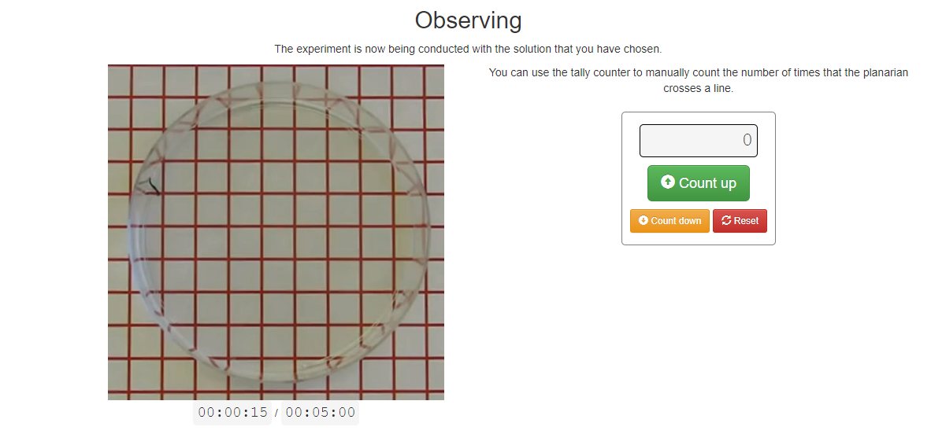
PLANARIAN OBSERVATION: PROCEDURE
2. Count the number of times the planarian crosses a line in 5 minutes.
Time controller: 5 minutes.
Notes:
4

Slide 5
PLANARIAN OBSERVATION: PROCEDURE
3. Choose the sugar solution and count the number of times the planarian crosses a line in 5 minutes.
4. Choose the ginseng solution and count the number of times the planarian crosses a line in 5 minutes.
5. Choose the caffeine solution and count the number of times the planarian crosses a line in 5 minutes.
6. Choose the taurine solution and count the number of times that the planarian crosses a line during 5 minutes.
Notes:
5

Slide 6
PLANARIAN OBSERVATION: ANALYSIS
Compare the results:
In the control solution (pond water) the planarian crossed a line _______ times.
In the sugar solution the planarian crossed a line _______ times.
In the ginseng solution the planarian crossed a line _______ times.
In the caffeine solution, the planarian crossed a line _______ times.
In the taurine solution, the planarian crossed a line _______ times.
The difference between the number of times the planarian crossed a line in the control solution and in the ______________ solution is the minimum.
The difference between the number of times the planarian crossed a line in the control solution and in the ______________ solution is the maximum.
Notes:
6

Slide 7
PLANARIAN OBSERVATION: CONCLUSIONS
a) Which of the substances increased the planarian’s movement the most? Why?
b) Which of the substances decreased the planarian’s movement the most? Why?
c) Which substance can be considered as a stimulant of the planarian’s nervous system? Why?
d) Which substance can be considered as a depressant or inhibitor of the planarian’s nervous system? Why?
e) Search for information about the effects of caffeine and taurine on the human nervous system. Do they have the same effects in humans as in planarians? Why?
f) On which vital function is this experiment based on: nutrition, interaction or reproduction? Why?

